Slide 1
Lesson 1 - Revision
OSI
Layer2 & Layer3 fundamentals
ARP
IP Addressing, Subnetting
Vlans, Trunking, Inter Vlan routing
Static Routing
RIP
Summarisation

Slide 2
Resources
Cisco Product / Technology guides
http://www.cisco.com/cisco/web/psa/general.html?mode=tech
2960 Switch software configuration guide
http://www.cisco.com/c/en/us/td/docs/switches/lan/catalyst2960/software/release/12-2_55_se/configuration/guide/scg_2960.html
Cisco IOS 15.1(4)M References / Guides
http://www.cisco.com/c/en/us/support/ios-nx-os-software/ios-software-release-15-1-4-m/model.html

Slide 3
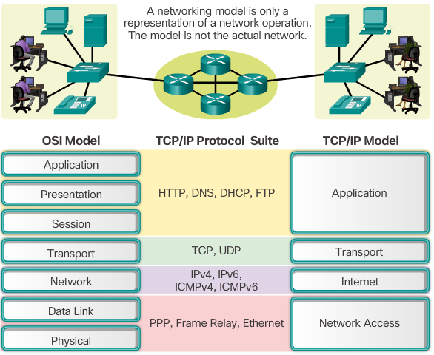
Notes:
Common communication
Physical = Transmission and reception of raw bit streams over a physical medium (copper, fibre, wireless)
Data Link = transmission of data frames between two nodes connected by a physical layer
MAC (Media access control) & LLC (software driver, identify upper layers)
Network/Internet = Routing (determine best path). IP addressing
Transport = Segmenting data, reliable delivery, multiplexing

Slide 4
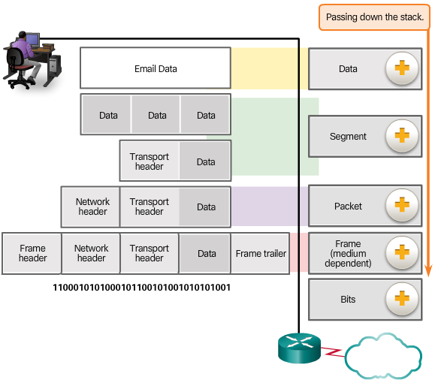
Protocol Data Units
Encapsulation
Data
Segment
Packet
Frame
Bits
Notes:
Router considered a L3 device – makes decisions based on packet header
Switch considered a L2 device – makes decisions based on frame header
Firewall operates at layer 3 & 4
L2 = src & dst MAC address (ethernet)
L3 = src & dst IP address
L4 = src & dst port

Slide 5
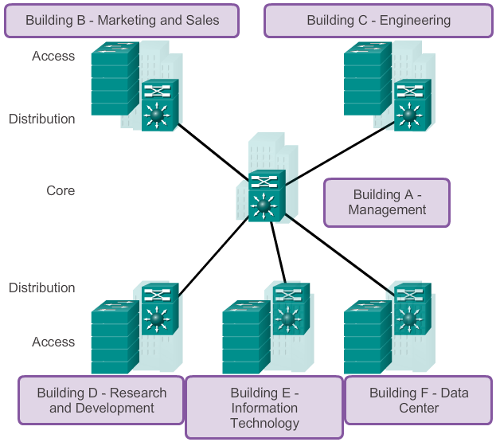
Core, Distribution, Access
Notes:
Core – high speed packet switching, separate failure domains – router / multilayer switch
Distribution – Policy (FW, ACL), QoS – router / multilayer switch
Access – end device connection, QoS – switch

Slide 6
Collision Domains
A collision domain is the segment where devices must compete to communicate.
All ports of a hub belong to the same collision domain.
Every port of a switch is a collision domain on its own.
A switch break the segment into smaller collision domains, easing device competition.
Notes:
Microsegmentation = split a larger collision domain into smaller ones in order to reduce collision probability

Slide 7
Broadcast Domains
A broadcast domain is the extend of the network where a broadcast frame can be heard.
Switches forward broadcast frames to all ports; therefore, switches do not break broadcast domains.
All ports of a switch, with its default configuration, belong to the same broadcast domain.
All ports of a router belong to a different broadcast domain.
If two or more switches are connected, broadcasts are forwarded to all ports of all switches, except for the port that originally received the broadcast.

Slide 8
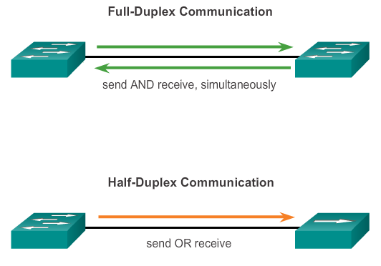
Configuring Switch Ports Duplex Communication
Notes:
Negotiated or fixed
Full duplex does not use CSMA/CD
Switch – full duplex
Hub – half duplex

Slide 9
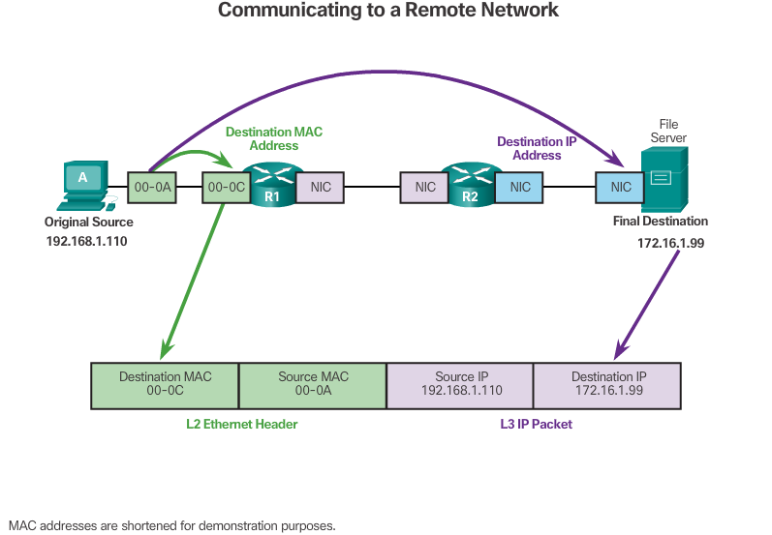
Destination on a Remote Network
Notes:
End devices connected via switch to router (switch not shown above)
L2 = header changes at each hop / media
L3 = end to end
Router port on same network as end device will be used as default gateway

Slide 10
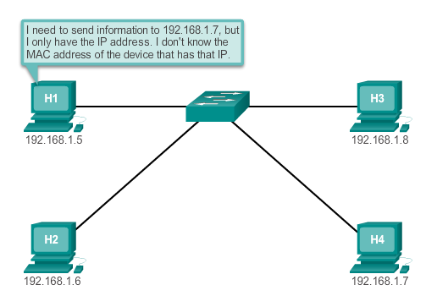
ARP
Notes:
ARP Purpose
Sending node needs a way to find the MAC address of the destination for a given Ethernet link
The ARP protocol provides two basic functions:
Resolving IPv4 addresses to MAC addresses
Maintaining a table of mappings

Slide 11
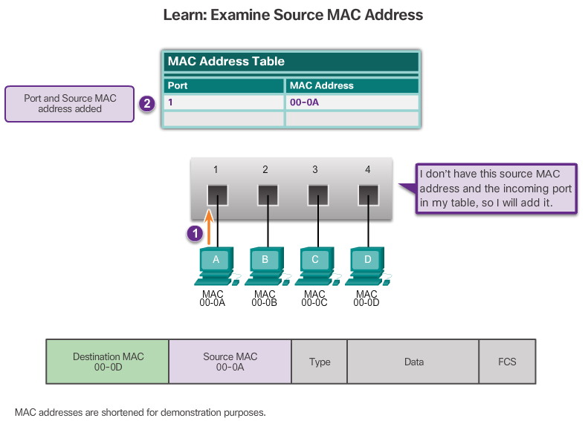
Switch: Learning MAC Addresses
Notes:
Switch Operation

Slide 12
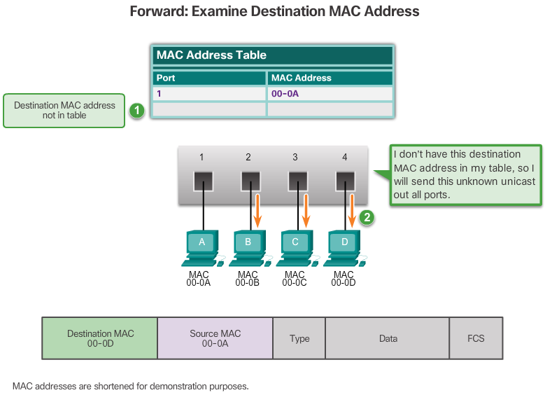
Learning MAC Addresses (cont.)
Notes:
show mac-address table

Slide 13
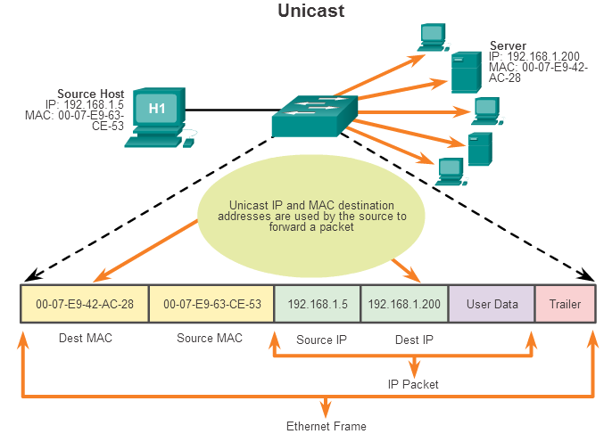
Unicast MAC Address
Notes:
Switch operation – will forward to all ports except port received on if no entry in the MAC address table

Slide 14
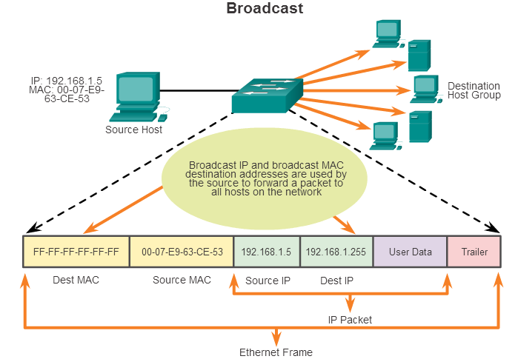
Broadcast MAC Address

Slide 15
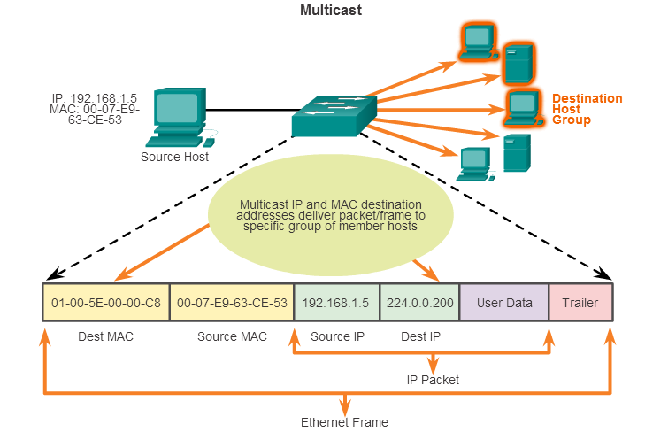
Multicast MAC Address
Notes:
Special destination MAC for multicast
Always starts with 01-00-5E

Slide 16
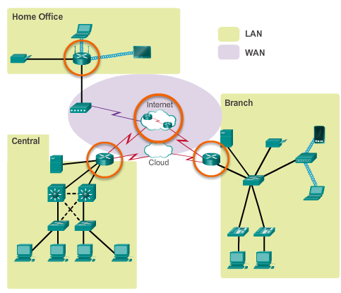
Functions of a Router Routers Interconnect Networks
Routers can connect multiple networks.
Routers have multiple interfaces, each on a different IP network.
Notes:
4.1.1.4 Routers Interconnect Networks

Slide 17
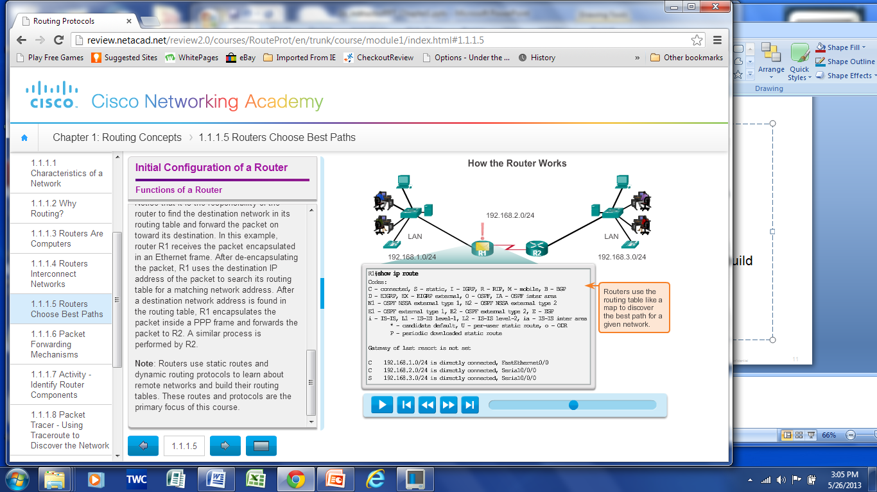
Functions of a Router Routers Choose Best Paths
Notes:
4.1.1.5 Routers Choose Best Paths

Slide 18
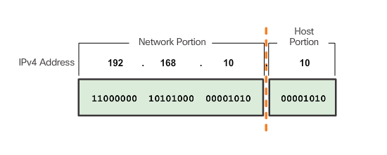
Network and Host Portions
One portion of the 32 bit IPv4 address identifies the network, and another portion identifies the host.
Notes:
7.1.2.1 Network and Host Portions

Slide 19
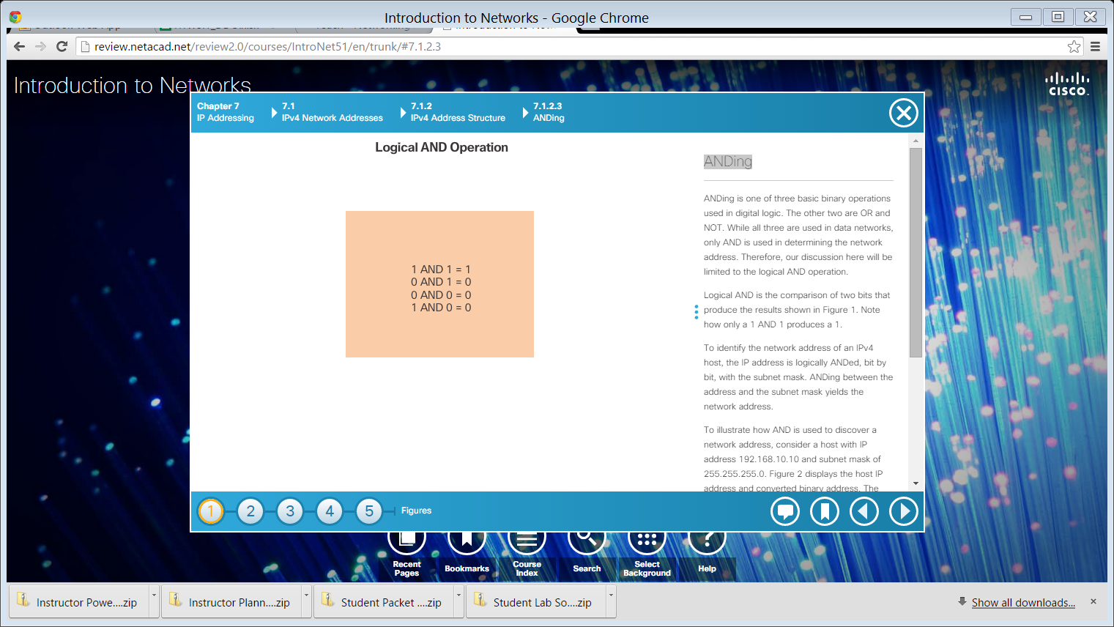
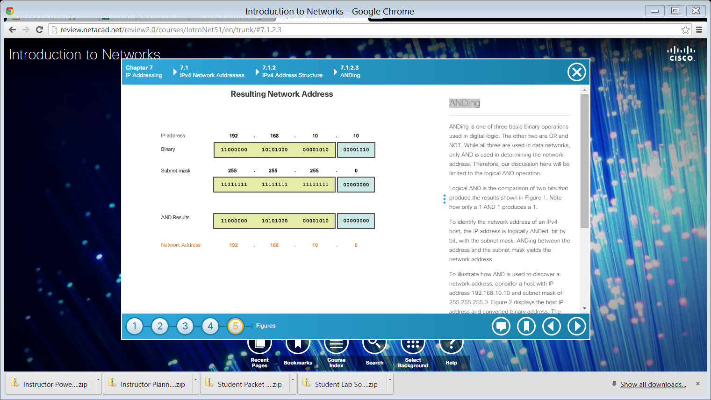
ANDing
Logical AND is the comparison of two bits.
ANDing between the IP address and the subnet mask yields the network address.
Notes:
Network address = host portion is all 0s
Broadcast address = host portion is all 1s

Slide 20
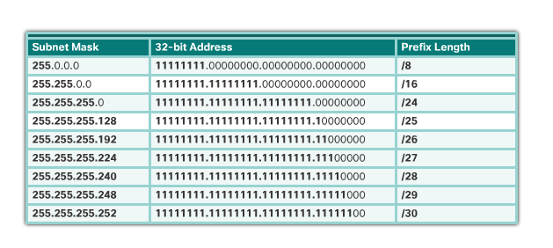
The Prefix Length
Subnet Mask & CIDR notation
Notes:
Explain binary AND

Slide 21
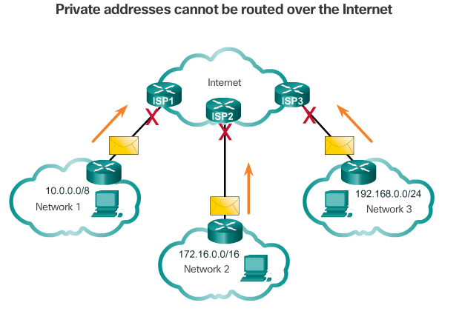
Public and Private IPv4 Addresses
Private Addresses:
10.0.0.0/8 or 10.0.0.0 to10.255.255.255
172.16.0.0 /12 or 172.16.0.0 to 172.31.255.255
192.168.0.0 /16 or 192.168.0.0 to 192.168.255.255

Slide 22
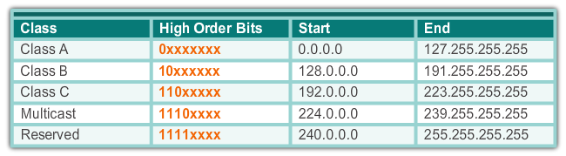
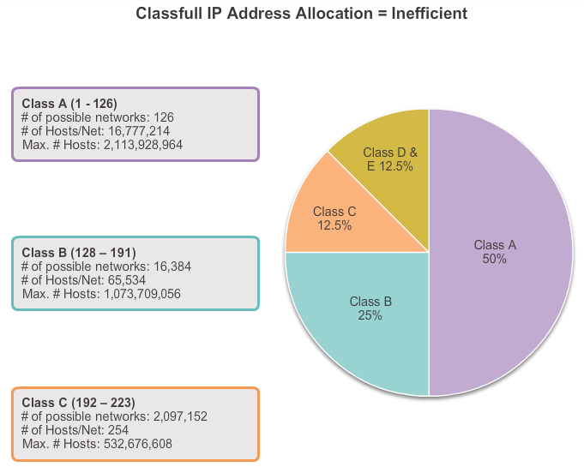
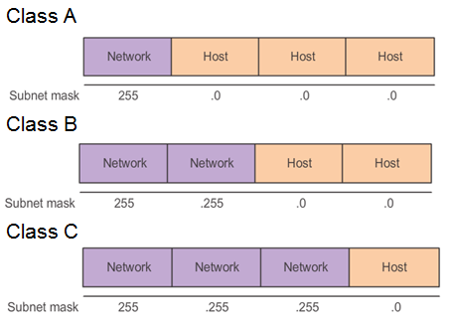
Classful Network Addressing
Notes:
6.3.1.1 Classful Network AddressingUsing classful IP addresses meant that the subnet mask of a network address could be determined by the value of the first octet, or more accurately, the first three bits of the address.
In the early days of the Internet, organisations were assigned an entire classful network address from the A, B, or C class.
Class A had 50% of the total address space. However, only 126 organisations could be assigned a class A network address.
Class B had 25% of the total address space. Up to 16,384 organizations could be assigned a class B network address and each of these networks could support up to 65,534 hosts.
Class C had 12.5 % of the total address space. Many more organizations were able to get class C networks, but were limited in the total number of hosts that they could connect.

Slide 23
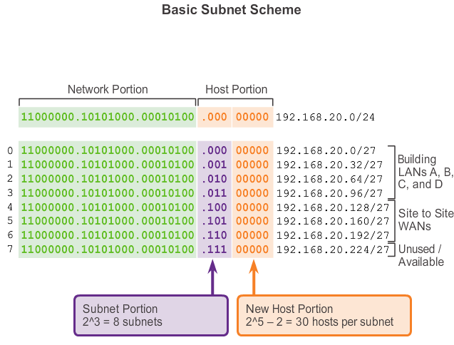
Fixed Length Subnet Masking

Slide 24
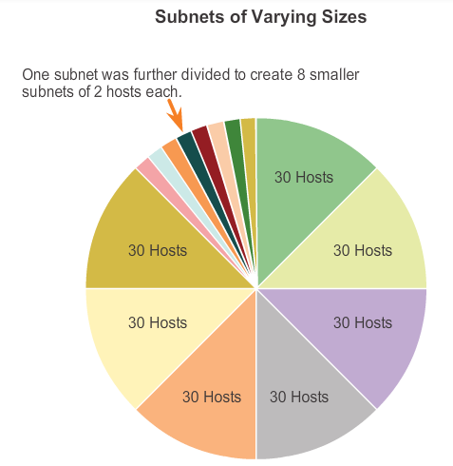
VLSM Variable Length Subnet Masking
Notes:
Why 2 hosts?

Slide 25
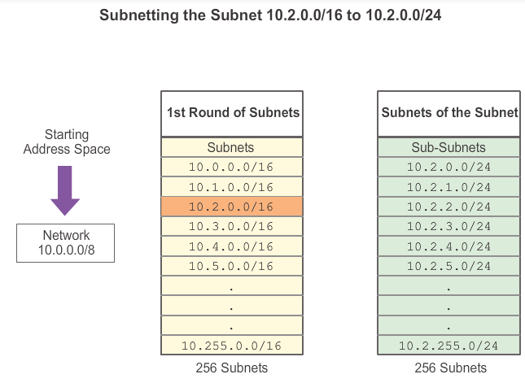
VLSM Subnetting Subnets
Notes:
6.3.3.4 Subnetting Subnets

Slide 26
Overview of VLANs VLAN Definitions
A VLAN is a logical partition of a Layer 2 network.
Multiple partitions can be created, allowing for multiple VLANs to co-exist.
Each VLAN is a broadcast domain, usually with its own IP network.
VLANs are mutually isolated and packets can only pass between them via a router.
The partitioning of the Layer 2 network takes place inside a Layer 2 device, usually via a switch.
The hosts grouped within a VLAN are unaware of the VLAN’s existence.

Slide 27
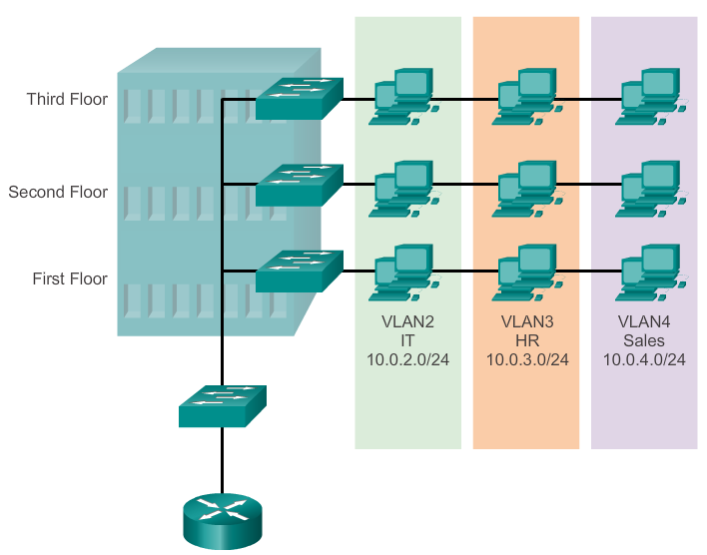
Overview of VLANs VLAN Definitions (cont.)
Notes:
Best practice = Map Vlans to IP subnets
Benefits
Security
Cost reduction
Better performance
Shrink broadcast domains
Improved IT staff efficiency
Simpler project and application management

Slide 28
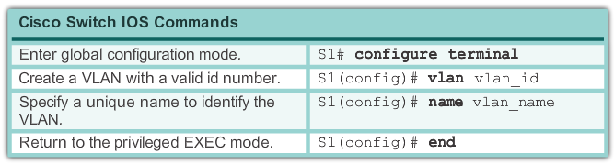
VLAN Assignment Creating a VLAN
Notes:
3.2.1.2 Creating a VLAN

Slide 29
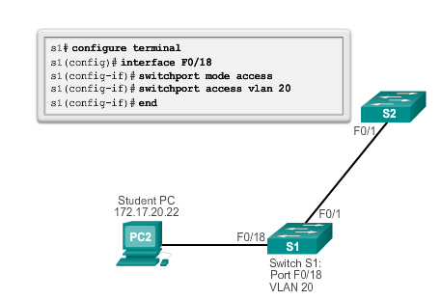
VLAN Assignment Assigning Ports to VLANs (cont.)
Notes:
show vlan brief

Slide 30
VLANs in a Multi-Switched Environment VLAN Trunks
A VLAN trunk carries more than one VLAN.
A VLAN trunk is usually established between switches so same-VLAN devices can communicate, even if physically connected to different switches.
A VLAN trunk is not associated to any VLANs; neither is the trunk ports used to establish the trunk link.
Cisco IOS supports IEEE802.1q, a popular VLAN trunk protocol.

Slide 31
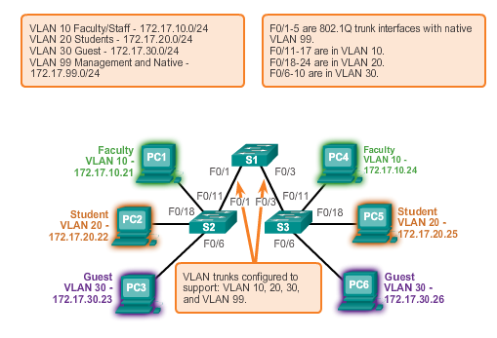
VLANs in a Multi-Switched Environment VLAN Trunks

Slide 32
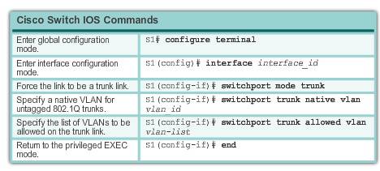
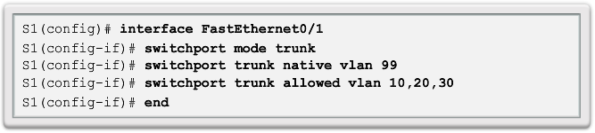
VLAN Assignment Configuring IEEE 802.1q Trunk Links
Notes:
Native Vlan – untagged traffic for legacy support or non Cisco

Slide 33
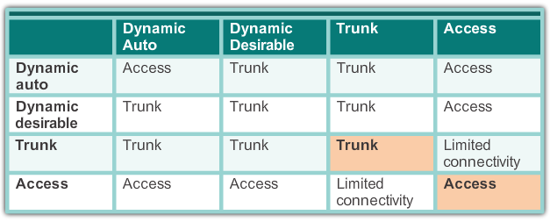
Dynamic Trunking Protocol Negotiated Interface Modes
Cisco Catalyst 2960 and 3560 support the following trunk modes:
Switchport mode dynamic auto
Switchport mode dynamic desirable
Switchport mode trunk
Switchport nonegotiate
Notes:
Default = 2960 = dynamic auto

Slide 34
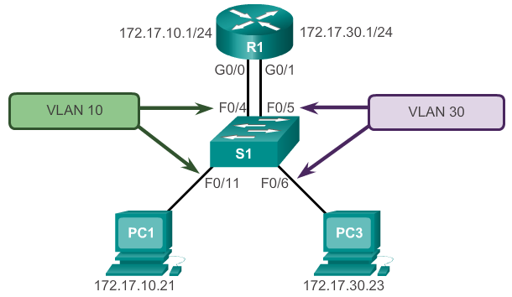
What is Inter-VLAN routing?
Layer 2 switches cannot forward traffic between VLANs without the assistance of a router.
Inter-VLAN routing is a process for forwarding network traffic from one VLAN to another, using a router.
Notes:
Above = Legacy inter vlan routing

Slide 35
Inter-VLAN Routing Operation Router-on-a-Stick Inter-VLAN Routing
The router-on-a-stick approach uses a different path to route between VLANs.
One of the router’s physical interfaces is configured as a 802.1Q trunk port so it can understand VLAN tags.
Logical subinterfaces are created; one subinterface per VLAN.
Each subinterface is configured with an IP address from the VLAN it represents.
VLAN members (hosts) are configured to use the subinterface address as a default gateway.
Only one of the router’s physical interface is used.
Notes:
Option 2 = Router-on-a-Stick Inter-VLAN Routing (above & next slide)
Option 3 = Modern networks use multilayer (layer3) switches to route between SVIs

Slide 36
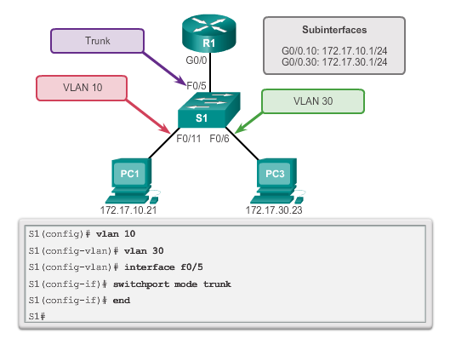
Configure Router-on-a-Stick Switch Configuration
Notes:
6.1.3.2 Configure Router-on-a-Stick: Switch Configuration

Slide 37
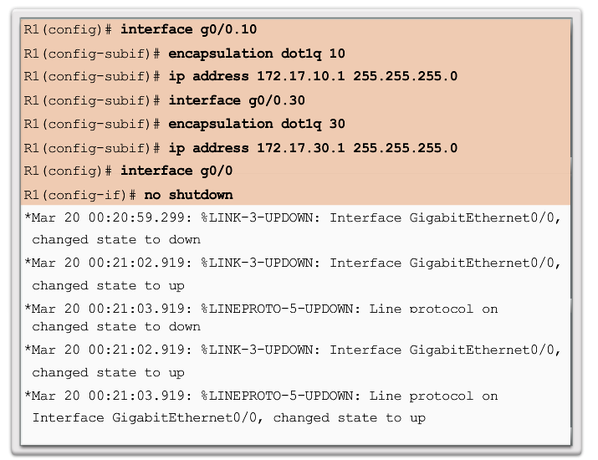
Configure Router-on-a-Stick Router Subinterface Configuration
Notes:
6.1.3.3 Configure Router-on-a-Stick: Router Subinterface Configuration

Slide 38
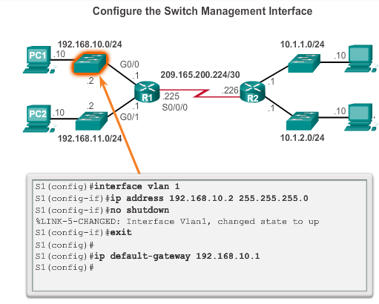
L2 Switch Management
Network infrastructure devices require IP addresses to enable remote management.
On a switch, the management IP address is assigned on a virtual interface.

Slide 39
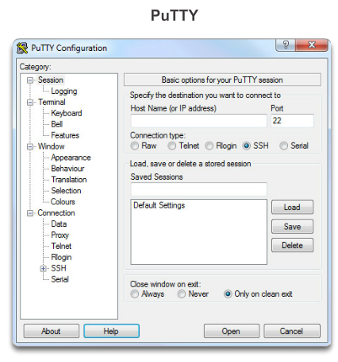
Accessing a Cisco IOS Device Terminal Emulation Programs
Software available for connecting to a networking device:
PuTTY
Tera Term
SecureCRT
HyperTerminal
OS X Terminal
Notes:
Telnet
Method for remotely accessing the CLI over a network
Require active networking services and one active interface that is configured
Secure Shell (SSH)
Remote login similar to Telnet, but utilizes more security
Stronger password authentication
Uses encryption when transporting data
Console

Slide 40
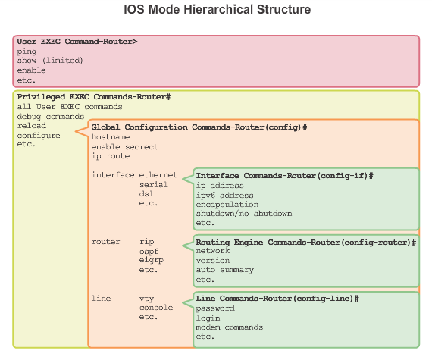
Navigating the IOS Cisco IOS Modes of Operation
Notes:
In hierarchical order from most basic to most specialized, the major modes are:
User executive (User EXEC) mode
Privileged executive (Privileged EXEC) mode – required to view configs, debug, view detailed stats
Global configuration mode
Other specific configuration modes, such as Interface configuration mode.
Each mode has a distinctive prompt

Slide 41
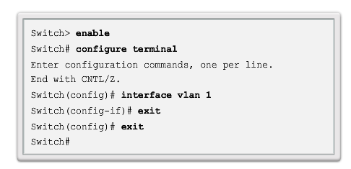
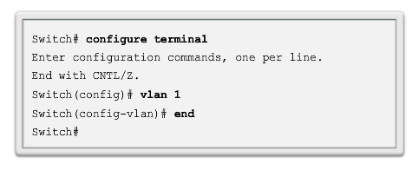
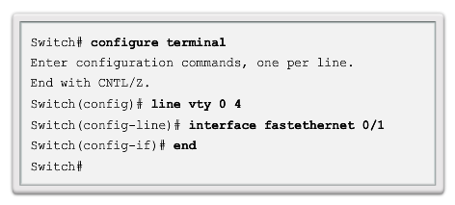
Navigating the IOS Navigating Between IOS Modes (cont.)
Notes:
To move from the global configuration mode to the privileged EXEC mode, you enter the command exit.
To move from any submode of the global configuration mode to the mode one step above it in the hierarchy of modes, enter the exit command.
To move from any submode of the privileged EXEC mode to the privileged EXEC mode, enter the end command or enter the key combination Ctrl+Z.
To move from any submode of the global configuration mode to another “immediate” submode of the global configuration mode, simply enter the corresponding command that is normally entered from global configuration mode

Slide 42
Hotkeys and Shortcuts
Tab – Completes the remainder of a partially typed command or keyword
Ctrl-R – Redisplays a line
Ctrl-A – Moves cursor to the beginning of the line
Ctrl-Z – Exits configuration mode and returns to user EXEC
Down Arrow – Allows the user to scroll forward through former commands
Up Arrow – Allows the user to scroll backward through former commands
Ctrl-Shift-6 – Allows the user to interrupt an IOS process such as ping or traceroute.
Ctrl-C – Aborts the current command and exits the configuration mode
Notes:
Context sensitive help
TAB auto complete

Slide 43
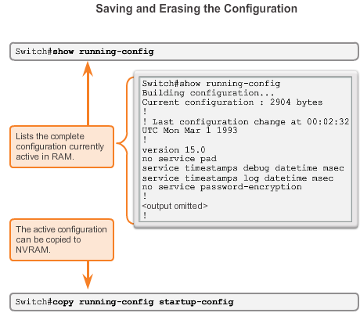
Saving Configurations Configuration Files
Startup configuration is removed by using the: erase startup-config
Switch# erase startup-config
Switch# reload
System configuration has been modified. Save? [yes/no]: n
Proceed with reload? [confirm]
On a switch, you must also issue the delete vlan.dat
Switch# delete vlan.dat
Delete filename [vlan.dat]?
Delete flash:vlan.dat? [confirm]
Notes:
device# erase startup-config
After the command is issued, the switch will prompt you for confirmation:
Erasing the nvram filesystem will remove all configuration files! Continue? [confirm]
Confirm is the default response. To confirm and erase the startup configuration file, press . Pressing any other key will abort the process.
Copy run to start – doesn’t erase running config, it is instead merged

Slide 44
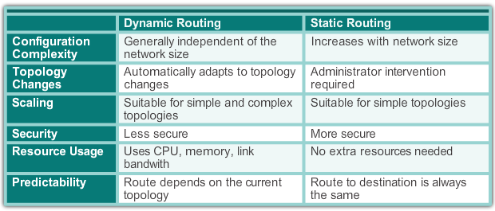
Static Routing Dynamic versus Static Routing
Notes:
6.1.1.2 Why Use Static Routing?
Static routing provides some advantages over dynamic routing, including:
Static routes are not advertised over the network, resulting in better security.
Static routes use less bandwidth than dynamic routing protocols, no CPU cycles are used to calculate and communicate routes.
The path a static route uses to send data is known.
Static routing has the following disadvantages:
Initial configuration and maintenance is time-consuming.
Configuration is error-prone, especially in large networks.
Administrator intervention is required to maintain changing route information.
Does not scale well with growing networks; maintenance becomes cumbersome.
Requires complete knowledge of the whole network for proper implementation.

Slide 45
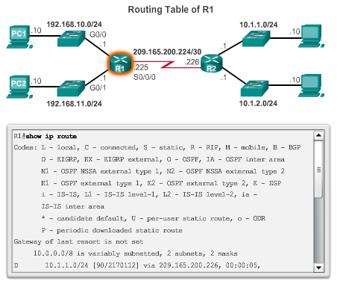
The Routing Table Routing Table Sources
Notes:
4.3.1.2 Routing Table Sources

Slide 46
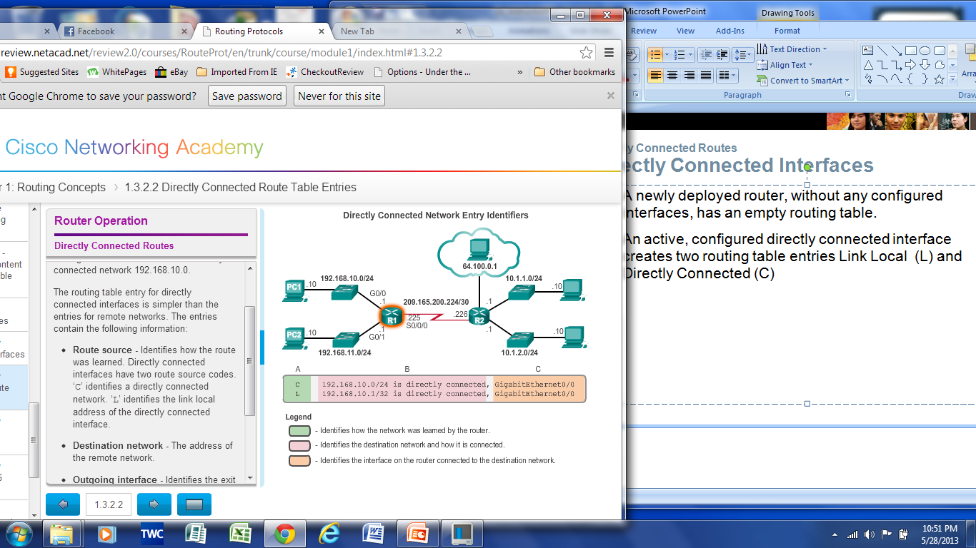
Directly Connected Routes Directly Connected Interfaces
A newly deployed router, without any configured interfaces, has an empty routing table. An active, configured, directly connected interface creates two routing table entries:
Link Local (L)
Directly Connected (C)
Notes:
4.3.2.1 Directly Connected Interfaces
4.3.2.2 Directly Connected Route Table Entries

Slide 47
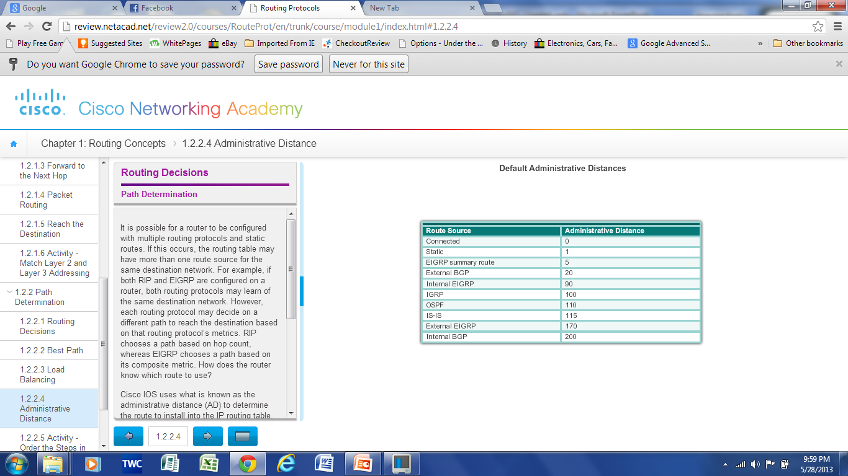
Path Determination of the route Administrative Distance
If multiple paths to a destination are configured on a router, the path installed in the routing table is the one with the lowest Administrative Distance (AD):
A static route with an AD of 1 is more reliable than an EIGRP-discovered route with an AD of 90.
A directly connected route with an AD of 0 is more reliable than a static route with an AD of 1.
Notes:
4.2.2.4 Administrative Distance
4.2.2.5 Activity – Order the Steps in the Packet Forwarding Process

Slide 48
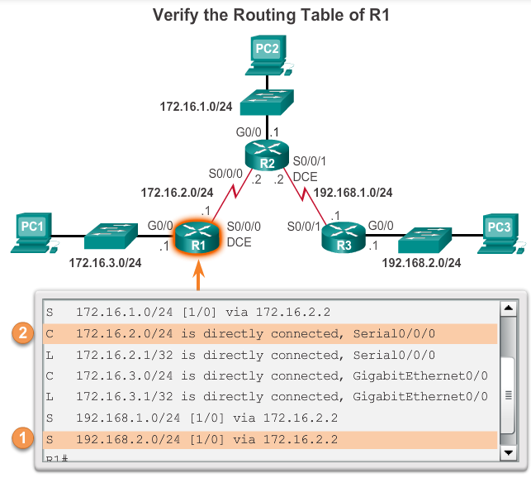
Configure a Next-Hop Static Route
When a packet is destined for the 192.168.2.0/24 network, R1:
Looks for a match in the routing table and finds that it has to forward the packets to the next-hop IPv4 address 172.16.2.2.
2. R1 must now determine how to reach 172.16.2.2; therefore, it searches a second time for a 172.16.2.2 match.
ip route 192.168.2.0 255.255.255.0 172.16.2.2
Notes:
Can specify next-hop ip, outgoing interface or both (legacy requirement).
Always use next- hop ip. Recurisive lookup does not occur with modern routers using CEF.
If you don't specify a next-hop, the next-hop router should be configured to do proxy ARP. What will happen is that your router will do an ARP request whenever a packet is sent to a new destination which is not in the ARP table and the next-hop router should respond with its MAC on behalf of destination. This configuration is not recommended as there will be both a delay initially to do the ARP and if you have many routes like this (or even worse, I saw default routes like this!) you'll see memory and high cpu issues.

Slide 49
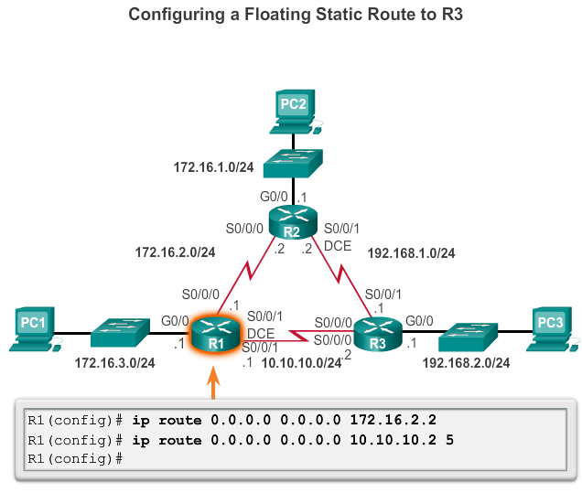
Configure Floating Static Routes Configure a Floating Static Route
Notes:
Floating static routes are static routes that have an administrative distance greater than the administrative distance of another static route or dynamic routes:
The administrative distance of a static route can be increased to make the route less desirable than that of another static route or a route learned through a dynamic routing protocol.
In this way, the static route “floats” and is not used when the route with the better administrative distance is active.
However, if the preferred route is lost, the floating static route can take over, and traffic can be sent through this alternate route.

Slide 50
RIP
router rip
version 2
no auto-summary
network 10.0.0.0
passive interface g0/1
default information-originate

Slide 51
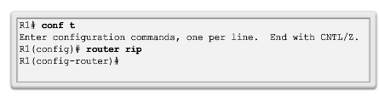
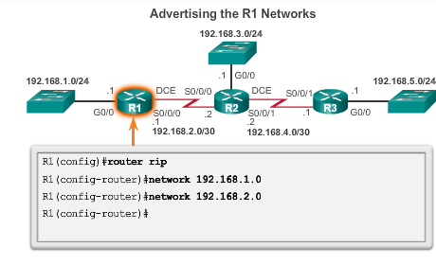
Configuring the RIP Protocol Router RIP Configuration Mode
Notes:
3.2 – RIPv2
3.2.1 – Configuring the RIP Protocol
3.2.1.1 – Router RIP Configuration Modes
Enables RIP on all interfaces that belong to a specific network. Associated interfaces now both send and receive RIP updates.
Advertises the specified network in RIP routing updates sent to other routers every 30 seconds.
Note: RIPv1 is a classful routing protocol for IPv4. Therefore, if a subnet address is entered, the IOS automatically converts it to the classful network address. For example, entering the network 192.168.1.32 command would automatically be converted to network 192.168.1.0 in the running configuration file. The IOS does not give an error message, but instead corrects the input and enters the classful network address.

Slide 52
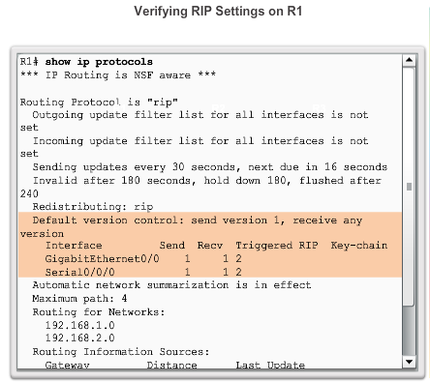

Configuring the RIP Protocol Enable and Verify RIPv2
Notes:
3.2 – RIPv2
3.2.1 – Configuring the RIP Protocol
3.2.1.4 – Enable and Verify RIPv2
RIPv2 = Multicast 224.0.0.9 (RIPv1 uses broadcasts)
Advertises network mask (RIPv1 does not) supports VLSM

Slide 53
Configuring the RIP Protocol Disable Auto Summarization
Similarly to RIPv1, RIPv2 automatically summarizes networks at major network boundaries by default.
To modify the default RIPv2 behavior of automatic summarization, use the no auto-summary router configuration mode command.
When automatic summarization has been disabled, RIPv2 no longer summarizes networks to their classful address at boundary routers. RIPv2 now includes all subnets and their appropriate masks in its routing updates.
Notes:
3.2 – RIPv2
3.2.1 – Configuring the RIP Protocol
3.2.1.5– Disable Automatic Summarization
e.g 10.1.1.0 /24 will be summarised as 10.0.0.0/8
Must disable in discontiguous networks
Classful
A = first octet = 0 – 127 /8
B = first octet = 128 – 191 /16
C = first octet = 192 – 223 /24

Slide 54


Configuring the RIP Protocol Configuring Passive Interfaces
Sending out unneeded updates on a LAN impacts the network in three ways:
Wasted Bandwidth
Wasted Resources
Security Risk
Notes:
3.2 – RIPv2
3.2.1 – Configuring the RIP Protocol
3.2.1.6 – Configuring Passive Interfaces

Slide 55


Configuring the RIP Protocol Propagate a Default Route
Notes:
3.2 – RIPv2
3.2.1 – Configuring the RIP Protocol
3.2.1.7– Propagate a Default Route

Slide 56

CIDR CIDR and Route Summarization
Notes:
Why?
Reduce routing table sizes – lookup faster, less memory consumed (performance)
Reduce size of updates (traffic)

Slide 57

Configure IPv4 Summary Routes Calculate a Summary Route

Slide 58


Configure IPv4 Summary Routes Summary Static Route Example

Slide 59

Purpose of ACLs What is an ACL?
Notes:
9.1.1.1 What is an ACL?

Slide 60
Purpose of ACLs Packet Filtering
Packet filtering, sometimes called static packet filtering, controls access to a network by analyzing the incoming and outgoing packets and passing or dropping them based on given criteria, such as the source IP address, destination IP addresses, and the protocol carried within the packet.
A router acts as a packet filter when it forwards or denies packets according to filtering rules.
An ACL is a sequential list of permit or deny statements, known as access control entries (ACEs).
Notes:
9.1.1.3 Packet Filtering

Slide 61

Purpose of ACLs ACL Operation
The last statement of an ACL is always an implicit deny. This statement is automatically inserted at the end of each ACL even though it is not physically present. The implicit deny blocks all traffic. Because of this implicit deny, an ACL that does not have at least one permit statement will block all traffic.
Notes:
9.1.1.5 ACL Operation

Slide 62

Standard versus Extended IPv4 ACLs Numbering and Naming ACLs
Notes:
9.1.2.2 Numbering and Naming ACLs

Slide 63
Wildcard Masks in ACLs Introducing ACL Wildcard Masking
Wildcard masks and subnet masks differ in the way they match binary 1s and 0s. Wildcard masks use the following rules to match binary 1s and 0s:
Wildcard mask bit 0 - Match the corresponding bit value in the address.
Wildcard mask bit 1 - Ignore the corresponding bit value in the address.
Wildcard masks are often referred to as an inverse mask. The reason is that, unlike a subnet mask in which binary 1 is equal to a match and binary 0 is not a match, in a wildcard mask the reverse is true.
Notes:
9.1.3.1 Introducing ACL Wildcard Masking
255.255.255.255 - <mask> = wildcard mask

Slide 64

Wildcard Masks in ACLs Examples Wildcard Mask Keywords
Notes:
9.1.3.5 Examples Wildcard Mask Keywords

Slide 65
Guidelines for ACL Placement Where to Place ACLs
Every ACL should be placed where it has the greatest impact on efficiency. The basic rules are:
Extended ACLs - Locate extended ACLs as close as possible to the source of the traffic to be filtered.
Standard ACLs - Because standard ACLs do not specify destination addresses, place them as close to the destination as possible.
Placement of the ACL and therefore the type of ACL used may also depend on: the extent of the network administrator’s control, bandwidth of the networks involved, and ease of configuration.
Notes:
9.1.5.1 Where to Place ACLs

Slide 66

Configure Standard IPv4 ACLs Applying Standard ACLs to Interfaces
Notes:
Standard ACL can only match source addresses / networks

Slide 67

Structure of an Extended IPv4 ACL Extended ACLs
Notes:
9.3.1.1 Extended ACLs

Slide 68

Configure Extended IPv4 ACLs Applying Extended ACLs to Interfaces
Notes:
9.3.2.2 Applying Extended ACLs to Interfaces
Keyword ‘any’ can be used instead of source and or destination

